Slide 1



MVP Application – QRM End to End automation
08th November 2024

Slide 2
Automation Tools for MVP
Category | Description​
Packer | Tool required to build the image with RLP’s embedded.
Terraform | Deploy the Azure VMs and PaaS services
GitHub CI\CD | GitHub Pipeline used to deploy the images and Azure VM’s.
Azure CLI | The Azure command-line interface (Azure CLI) is a set of commands used to create and manage Azure resources. The Azure CLI is available across Azure services and is designed to get you working quickly with Azure, with an emphasis on automation.
PowerShell | PowerShell is a cross-platform task automation solution made up of a command-line shell, a scripting language, and a configuration management framework. PowerShell runs on Windows, Linux, and macOS.
Ansible | Ansible used for post build configurations and post checks.

Slide 3
End to End Automation
Build QRM role images using Packer
QIS Server, HPC Nodes, SSAS, RDS
Install the required QRM provisioners and RLPs – PowerShell
Validation checks if RLPs are installed and if QRM provisioners are installed – Ansible
Terraform code will be used for VM creation – (using the image built by Packer)
Post provisioning and checks – Ansible if available
Compute and app infra provisioning – Terraform modules (VM module, Load balancer module, Storage account module, SQL DB module)
Single Full Stack Image does not fit for this application due to the following reasons:
Installation and configuration of the multiple dependent resources and software components (SQL MI, Blob Storage, HPC, SSAS, Azure Data Factory, File Server) must be individually provisioned and configured before you can run the QRM Integration Server (QIS) installation and configuration.
Once the QIS Server is up, we need to install and configure the QRM Client that the end user uses.
This gets complicated because the VMs must be AD joined, AD Services accounts must be assigned for most of the software components to run under, certificates must be installed for HPC and QRM communication/authorization.
All state for the HPC cluster and QRM applications are maintained in the databases

Slide 4
High level End to End flow (dependency view)

Slide 5
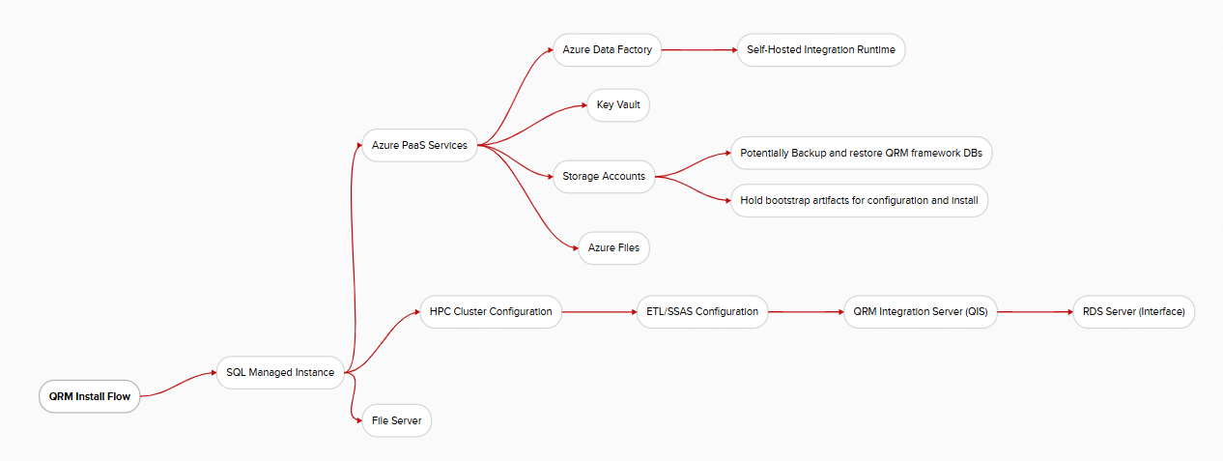
High level End to End flow (Installation)

Slide 6
Server Role – QRM Windows File Server
Pre-requisites:
HPC AD Service account and password
QRM AD Service account and password
QRM AD user security groups
Full Stack Image
Description | Source Image | CI/CD | Image Customizations
Image building process for the QRM Files Server | WF Golden Image | Packer GitHub Actions | Windows File Server Role (Installed) PowerShell Installation Scripts (Installed)
VM Module Creation
Description | Source Image | CI/CD | Output
Infrastructure and image deployment | QRM_FS | Terraform Cloud | File Server VM deployed
Description | Configuration | Playbooks | Output
QRM File Server Post-deployment configuration | Ansible | QRM_FS | Domain joined virtual machine Disk storage for data and logs configured with ACLs

Slide 7
Server Role – HPC Head Node(s)
Pre-requisites:
HPC AD Service account and password
HPC Certificate from Wells Fargo
Empty HPC configuration databases (7) provisioned in SQL MI with SQL Auth account access and permissions
Full Stack Image
Description | Source Image | CI/CD | Image Customizations
Image building process for the QRM HPC Head Node(s) | WF Golden Image | Packer GitHub Actions | HPC Certificate (Installed) .NET 4.8 Framework with latest patches (Installed) SQL Server Management Studio 20 (Installed) SQL CMD 2022 (Installed) PowerShell Installation Scripts (Installed) Autosys and NDM binaries HPC Pack 2019 Update 2 installation binary
VM Module Creation
Description | Source Image | CI/CD | Output
Infrastructure and image deployment | QRM_HPC_HN | Terraform Cloud | HPC Head Node VM(s) deployed
Description | Configuration | Playbooks | Output
QRM HPC Head Node Post-deployment configuration | Ansible | QRM_HPC_HN | Domain joined virtual machine(s) Autosys installed and configured NDM installed and configured HPC Head Node installed and configured

Slide 8
Server Role – HPC Worker Node(s)
Pre-requisites:
HPC AD Service account and password
HPC Certificate from Wells Fargo
Configured HPC Worker Node(s)
Full Stack Image
Description | Source Image | CI/CD | Image Customizations
Image building process for the QRM HPC Worker Node(s) | WF Golden Image | Packer GitHub Actions | HPC Certificate (Installed) .NET 4.8 Framework with latest patches (Installed) Putty + Gen (Installed) SQL compact (Installed) PowerShell Installation Scripts (Installed)
VM Module Creation
Description | Source Image | CI/CD | Output
Infrastructure and image deployment | QRM_HPC_WN | Terraform Cloud | HPC Worker Node VM(s) deployed
Description | Configuration | Playbooks | Output
QRM HPC Worker Node Post-deployment configuration | Ansible | QRM_HPC_WN | Domain joined virtual machine(s) HPC Worker Node installed and configured

Slide 9
Server Role – SQL Server Analysis Service (SSAS)
Pre-requisites:
SSAS AD Service account and password
HPC Certificate from Wells Fargo
SQL MI
Full Stack Image
Description | Source Image | CI/CD | Image Customizations
Image building process for the QRM SSAS server | WF Golden Image | Packer GitHub Actions | HPC Certificate (Installed) .NET 4.8 Framework with latest patches (Installed) SQL Server Management Studio 20 (Installed) MS Access DB Engine driver (Installed) MS SQL OLE DB driver (Installed) Putty + Gen (Installed) HPC Client (Installed) PowerShell Installation Scripts (Installed) SSAS 2022 installation binary
VM Module Creation
Description | Source Image | CI/CD | Output
Infrastructure and image deployment | QRM_SSAS | Terraform Cloud | SSAS VM(s) deployed
Description | Configuration | Playbooks | Output
QRM SSAS server Post-deployment configuration | Ansible | QRM_SSAS | Domain joined virtual machine(s) SSAS installed and configured

Slide 10
Server Role - QRM Integration Server (QIS)
Pre-requisites:
Empty QRM configuration databases (3) provisioned in SQL MI with SQL Auth account access and permissions
HPC Cluster provisioned and configured
SSAS server(s) provisioned and configured
Azure Data Factory provisioned and configured
QRM AD Service account and password
Full Stack Image
Description | Source Image | CI/CD | Image Customizations
Image building process for the QIS server | WF Golden Image | Packer GitHub Actions | HPC Certificate (Installed) .NET 4.8 Framework with latest patches (Installed) SQL Server Management Studio 20 (Installed) MS Access DB Engine driver (Installed) MS SQL OLE DB driver (Installed) QRM server/client installation binary HPC Pack 2109 Update 2 client tools installation binary
VM Module Creation
Description | Source Image | CI/CD | Output
Infrastructure and image deployment | QRM_QIS | Terraform Cloud | QIS VM(s) deployed
Description | Configuration | Playbooks | Output
QRM QIS Post-deployment configuration | Ansible | QRM_QIS | Domain joined server(s) HPC client installed and configured QIS installed and configured

Slide 11
Server Role – Remote Desktop Server (RDS)
Pre-requisites:
SSAS server(s) provisioned and configured
Azure Data Factory provisioned and configured
QIS provisioned and configured
QRM AD Service account and password
Full Stack Image
Description | Source Image | CI/CD | Image Customizations
Image building process for the QRM RDS | WF Golden Image | Packer GitHub Actions | Remote Desktop Services Role (Installed) .NET 4.8 Framework with latest patches (Installed) SQL Server Management Studio 20 (Installed) MS Access DB Engine driver (Installed) MS SQL OLE DB driver (Installed) End User Productivity Software (Installed) PowerShell Installation Scripts (Installed) Autosys , NDM , SQLCMD binaries HPC Pack 2019 Update 2 client tools installation binary QRM server/client installation binary
VM Module Creation
Description | Source Image | CI/CD | Output
Infrastructure and image deployment | QRM_RDS | Terraform Cloud | QRM RDS VM(s) deployed
Description | Configuration | Playbooks | Output
QRM RDS Post-deployment configuration | Ansible | QRM_RDS | Domain joined server(s) RDS roles configured Remote Desktop Services configured Autosys installed and configured NDM installed and configured HPC client installed and configured QRM client installed and configured

Slide 12
Risks
Harness as the CD – This team being the first to utilize Harness to deploy Terraform and/or Ansible.
Harness not being a familiar tool for our team.

Slide 13
Next Steps
Automation end to end decision

Slide 14
Thank you

Slide 15
Appendix

Slide 16
Server Role - <Role>
Pre-requisites: <prereqs>
Description | Source Image | CI/CD | Image Customizations
Description | Source Image | CI/CD | Output
Description | Configuration | Playbooks | Output

Slide 17
Action items
5 images built by packer and staged in the gallery
terraform to provision VMs and initialize with image
ansible + PowerShell automation for post config tasks
uber pipeline to orchestrate all steps
CI/Build --> Actions
CD orchestration --> Harness

